Slide 1
Secure Data Hiding in Image Using Steganography
CAPSTONE PROJECT
Presented By:
Student Name : Vanishka Satthemgari
College Name : Institute Of Aeronautical Engineering
Department : Computer Science and Engineering(Artificial Intelligence and Machine Learning)

Slide 2
OUTLINE
Problem Statement
Technology used
Wow factor
End users
Result
Conclusion
Git-hub Link
Future scope

Slide 3
Problem Statement
Traditional encryption methods protect data but leave it susceptible to detection and hacking.
Steganography enables secure data transmission by embedding secret messages within multimedia files.
Images are widely used as cover media due to their high pixel density and imperceptibility of minor changes.
This project focuses on image-based steganography where messages are hidden within pixel values.
Additional security is provided through password-protected message retrieval, ensuring only authorized users can decrypt the message.

Slide 4
Technology used
Programming Language: Python
Libraries Used:
OpenCV (cv2): For image processing and pixel manipulation.
OS module: For handling system-level operations.
Techniques Implemented:
Pixel Encoding & Decoding: Modifies pixel values to store message characters.
Dictionary-based Character Mapping: Maps characters to numerical values for easy encoding.
Password-based Decryption: Ensures secure message retrieval by verifying user credentials.

Slide 5
Wow factors
Password-Protected Encryption: Adds an extra security layer ensuring only authorized users can access hidden messages.
Minimal Image Distortion: Changes are imperceptible to the human eye, maintaining image quality.
Lightweight Implementation: Efficient and fast algorithm that works without heavy computational power.
Universal Usability: Can be implemented on any grayscale or colored image.
Stealth Communication: Messages remain undetectable unless decrypted using the correct passcode.
Versatility: Can be adapted for different image formats (JPEG, PNG, BMP).

Slide 6
End users
Government & Defense Organizations – Secure transmission of classified data without raising suspicion.
Journalists & Whistleblowers – Ensures safe exchange of confidential information.
Corporates & IT Security Teams – Protects sensitive business communication.
General Internet Users – Provides a method for secure personal messaging.
Forensic Experts & Law Enforcement – Used in cyber investigations and evidence protection.

Slide 7


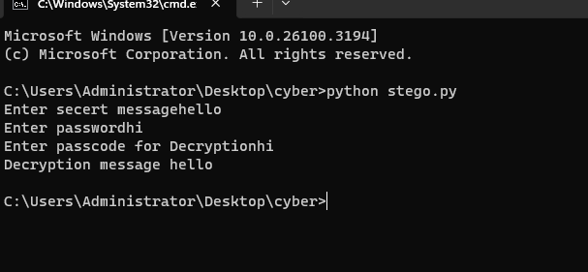
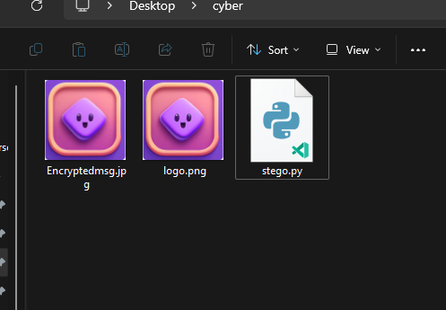
Results
Original Image
Encrypted Image
Decryption process
Files

Slide 8
Conclusion
Successfully implemented a secure image-based steganography system.
The project ensures data confidentiality while maintaining the integrity of the image.
By adding password protection, we enhance security and restrict unauthorized access.
This technique is highly applicable in secure messaging, cyber forensics, and classified data protection.
Future improvements can enhance encoding complexity to make the system even more robust.

Slide 9
GitHub Link
https://github.com/vanishkasatthemgari/Secure-Data-Hiding-in-Image-Using-Steganography

Slide 10
Future scope(optional)
Extending to Audio & Video Steganography: Implementing similar techniques in audio and video files for multi-format secure communication.
AI-Based Steganalysis Detection: Developing AI models to detect unauthorized steganography attempts.
Improving Encryption Techniques: Using advanced cryptographic methods to further secure hidden messages.
Cloud-Based Secure Messaging: Integrating steganography into cloud storage and messaging applications for end-to-end security.
Combining with Blockchain: Using blockchain to track and verify encrypted messages, ensuring authenticity.

Slide 11
THANK YOU

